Slide 1
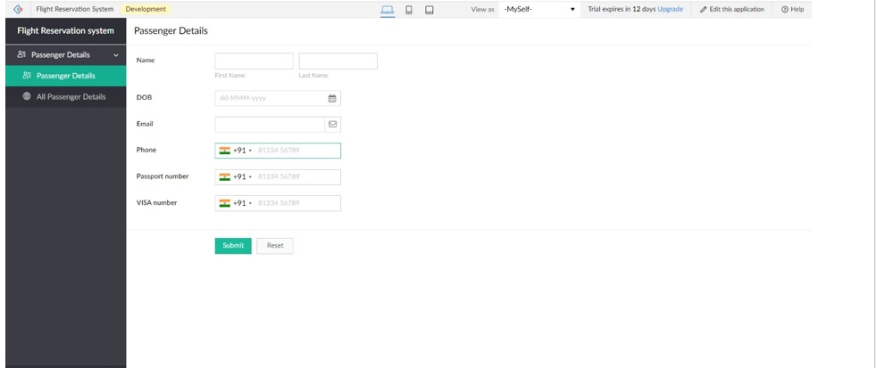
EXPERIMENT 2 Create a simple cloud software application for Flight Reservation System using any Cloud Service Provider to demonstrate SaaS

